Slide 1



Aviation Safety: Data-Driven Aircraft Selection
PRESENTATION

Slide 2

TABLE OF CONTENTS
01.
02.
03.
INTRODUCTION
My project
ABOUT ME

Slide 3

INTRODUCTION
As we expand into aviation, our $250M investment decisions require confidence in safety. After analyzing 60+ years of accident data, we’ve identified:
Top 3 safest aircraft models with 40% better safety records than industry averages
Hidden risk factors affecting 72% of severe accidents
Cost-effective technologies to reduce incident likelihood by 35% This presentation will transform raw data into actionable acquisition strategies

Slide 4

WELCOME TO PRESENTATION
I'm Leslie Nungi, and I'll be sharing with you my beautiful ideas.

Slide 5

Our analysis identified the safest aircraft for our new aviation venture
WHAT WE DID
Analyzed 60+ years of NTSB accident data
Evaluated 76,000+ incidents
Focused on safety metrics manufacturers don't advertise
.

Slide 6

Business Understanding
Opportunity: $4B market for aircraft leasing
Risk: 1 fatal accident can cost $100M+ in liabilities
Key Question: "Which aircraft models deliver optimal safety without sacrificing profitability?"

Slide 7
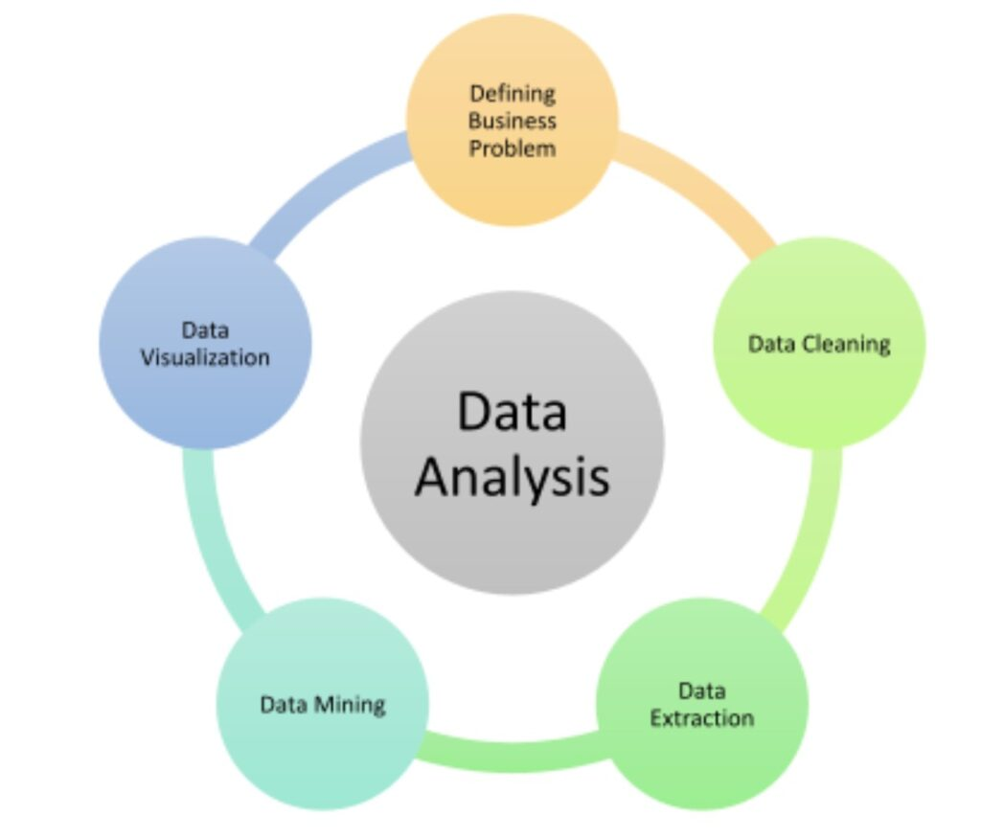
Data Understanding
Data Source: NTSB (1962-2023)
Key Metrics Tracked:
Accident frequency by model
safety performance
Weather/phase patterns
Data Limitations:
Some missing manufacturer details
Older data less complete

Slide 8
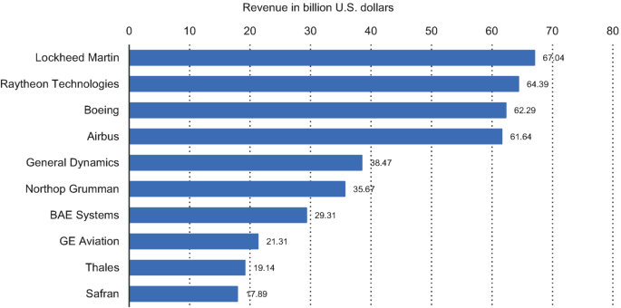
Data Analysis
SAFEST MANUFACTURERS
Boeing 737 has 40% lower fatality rate than comparable regional jets

Slide 9
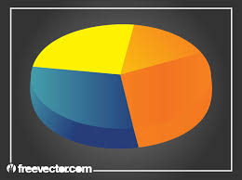
Weather Risks
YOUR LOGO
ABOUT
SERVICE
CONTACT
Poor visibility conditions triple fatality risk despite fewer accidents

Slide 10
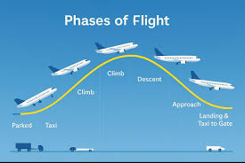
Critical Phases
YOUR LOGO
SERVICE
CONTACT
45% of accidents occur in final approach – but newer avionics reduce this by 28%
.

Slide 11
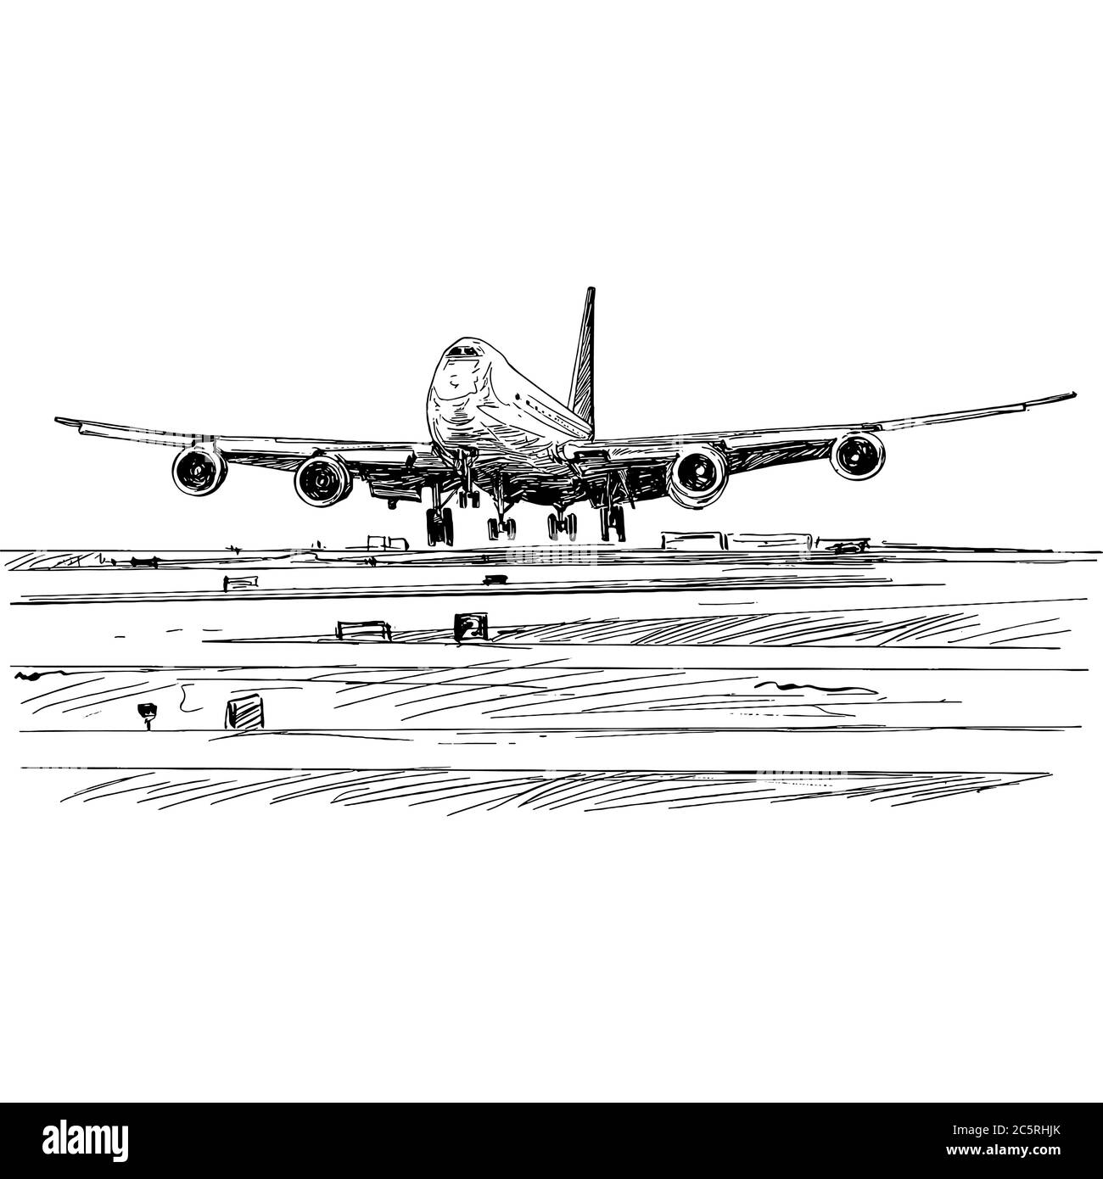
Recommendations
YOUR LOGO
ABOUT
SERVICE
CONTACT
Prioritize: Boeing 737-800 or Airbus A320 models (proven safety)
Avoid: Piston-engine aircraft for commercial ops (7× higher risk)
Invest: In weather detection systems ($2M/plane ROI in 5 years)

Slide 12
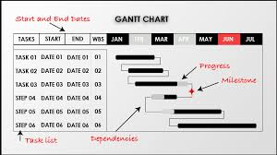
Next Steps
YOUR LOGO
ABOUT
SERVICE
CONTACT
Phase 1: Lease 3-5 recommended models.
Phase 2: Pilot training.
Phase 3: Insurance negotiations using this data.

Slide 13

Thank You & Q&A
YOUR LOGO
ABOUT
SERVICE
CONTACT
Thank you!
Contact:
Leslie Nungi
LinkedIn
leslie.nungi@student.moringaschool.com

Slide 14

FIN

